Slide 1
ACF 302 – Corporate Finance Introductory session Week L11

Slide 2
Outline
Part I: Introductions
Part II: Overview of the Module
Part III: Form of delivery
Part IV: Assessment: Setting expectations about final exam and term test.

Slide 3
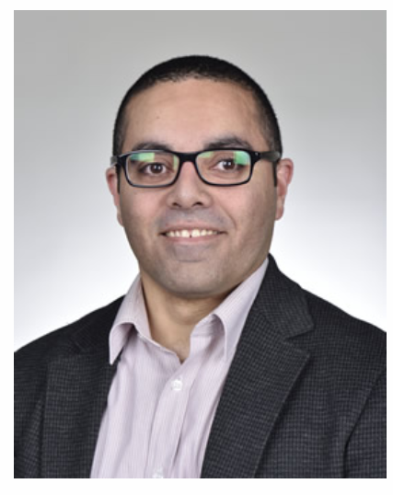
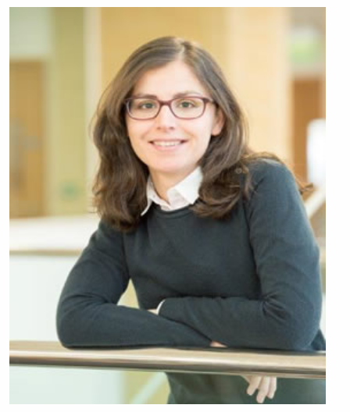
Module directors
Dr. Mohamed Ghaly
Office C014, C floor, Charles Carter
m.ghaly@lancaster.ac.uk
Office hours: Tuesday and Friday 14:00 -15:00. Please send me an email beforehand to book a slot.
Dr. Patricia Boyallian
Office C42, C floor, Charles Carter
p.boyallian@lancaster.ac.uk
Office hours: Wednesday 14:00 – 15:00. Please send me an email beforehand to book a slot.

Slide 4
Part II: Overview of the module
This is close to an Advanced Corporate Finance / Financial Management module.
The module builds on and extends the concepts covered in the introductory financial management modules (AcF100 and AcF214) and introduces advanced topics in corporate finance.
This module equips students with the knowledge to apply the techniques that have been developed in corporate finance to real world situations.
We want students to be able to use what they learn in the decision making process (working in M&A division at IB, CFO, Financial Advisory, etc).

Slide 5

Part II: Overview of the module – Main Textbook
Berk, J. & P. DeMarzo (2016) Corporate Finance, 4th Edition (Global ed.), Pearson Education (Ch18, 22, 23, 24, 25, 26, 27, 28, and 29).
The course requires good knowledge of some of the material you covered in AcF214.
Background Reading (from prerequisite courses): Berk and DeMarzo - Chapters 3 (section 3.3); 4 (section 4.9); 5 (section 5.5); 7 (sections 7.1, 7.5); 8 (sections 8.1, 8.2, 8.3); 12 (sections 12.5, 12.6); 14 (sections 14.1, 14.3); 15 (sections 15.1, 15.2, 15.4); 16 (section 16.9).

Slide 6
Part II: Overview of the module – Alternative Textbook
Damodaran: Applied Corporate Finance.
Hillier et al.: Corporate Finance.
Brealey & Myers: Principles of Corporate Finance.
Welch (free): Corporate Finance.
Brigham & Daves: Intermediate Financial Management.
Copeland & Weston: Financial Theory and Corporate Policy.
Grinblatt & Titman: Financial Markets and Corporate Strategy.
Asquith & Weiss: Lessons in Corporate Finance: A Case Studies Approach to Financial Tools, Financial Policies, and Valuation.

Slide 7
Part II: Overview of the module – Topics covered
 | Topics
Weeks 11 & 12 | Capital Budgeting and Valuation with Leverage
Week 13 | Real Options
Week 14 | Equity Financing
Week 15 | Debt Financing
Week 16 | Leasing
Week 17 | Short-term Financing
Weeks 18 & 19 | Mergers and Acquisitions
Week 20 | Corporate Governance

Slide 8
Part III: module delivery
Lecture
Workshop
Weekly list of exercises and questions to work at home.
In-person workshop with selected solutions.
Drop-in session
Weeks 14 , 16, 18 and 19
In person.
Workshop slides with all the answers to all the questions in the exercise sheet.
Session made of student’s questions related to previous weeks.
Office
Hours
Check regular hours scheduled on Moodle and Course Syllabus.
Contact by email or Teams.
Pre-recorded lecture videos
Lecture slides
Reading list: book chapter, articles, etc.

Slide 9
Part III: module delivery – Blended teaching
Blended environment that consists of pre-recorded lecture videos and in-person workshops + drop-ins.
Put the student in the driving seat.
Gives last year students the best of both worlds:
Flexibility for independent study and work at your own pace.
In-person contact with lecturer and colleagues for questions and interaction.
Drop-in sessions tailored to students needs.

Slide 10
Part III: module delivery – Drop in sessions
Drop-in sessions will be held and organized around requests submitted by students.
Requests can be anything:
lecture examples,
workshops exercises,
clarifying questions,
whatever you need!
Requests to be submitted by email, Teams, Moodle or anonymously in a link provided through Moodle.
Requests will be accepted until noon the day before the Drop-in session.

Slide 11
Part IV: Assessment
Term test (25%)
Final exam (75%)
Term test should allow you to demonstrate that you:
have been keeping up with the material during term.
Are familiar with the basic concepts.
Final exam is an instance where you should demonstrate that you:
have a more deeper understanding of topics covered.
can relate, connect and summarize concepts.
Can use what you’ve learnt to make decisions.

Slide 12
Part IV: Assessment – Term test
It will cover:
Capital Budgeting and Valuation with Leverage
Real Options
Equity Financing
Debt Financing
Leasing
Short-term Financing
25% of final mark
In person. Closed Book. Week 20 – Great Hall (check exact time and date on your time table).
1 hour test plus reading time.
Total 50 marks:
Section A: 10 multiple choice questions (2 marks each), 20 marks total)
Section B: 2 questions (15 marks each, 30 marks total)

Slide 13
Part IV: Assessment – Final exam
It will cover EVERYHTING:
Capital Budgeting and Valuation with Leverage
Real Options
Equity Financing
Debt Financing
Leasing
Short-term Financing
Mergers and Acquisitions.
Corporate Governance
75% of final mark
In person. Closed Book. May/June – Great Hall (check exact time and date on your time table).
Much longer that term test: think of approx. 2 hour test.
Total 100 marks:
Answer ALL questions from Section A: 10 MCQs (Total 30 marks)
Answer ALL questions from Section B: 4 questions (total 35 marks)
Answer ONE question from Section C: Answer EITHER Question 15 OR Question 16 (Total 35 marks)
SUPER important in the Final!!

Slide 14
Part IV: Assessment – In-person examination
AcF module undergraduate exams in summer will be held in person.
To provide reassurance and ensure you are fully prepared for these examinations, revision sessions will be provided for your AcF undergraduate modules in summer term (see i-Lancaster and Moodle for details of timetabled sessions for individual modules).
You may find the information on preparing for in person exams from the University website useful to review and there is also a section of LUMS learning development Moodle site specifically on Exams.
Past AcF module examination papers for summer examinations in are available from Moodle (see UG AccFin Departmental Notices).
Please note that we do not provide resit examination papers or solutions to prior year examinations or term test.

Slide 15
We hope you find the module interesting and engaging
and wish you all the best for the term ahead
Looking forward to meeting you!
☺

